Slide 1

Specialty
Steel
Products
At ESP Specialty Steel Products….. We Anticipate Your Needs!

Slide 2



As Your
Inventory Support Center….
ESP professionals maintain a high degree of market integrity while we strive to protect our customers’ inventory investments in
stainless steel bar
Notes:
ESP is committed to providing you with exceptional service while offering innovative Value Added Services. We consider our mill suppliers as partners and hold them to the highest standards. This means that our customers can be confident that they will consistently receive the highest quality stainless products from world-class producers.
ESP strives to anticipate the needs of customers by offering quality stainless and perforated metal products, ISO 9001:2008 certification, competitive lead times, 98% or better on-time delivery, quick-turn sawing and polishing, and customer-tailored inventory management programs with online visibility to inventory levels and inbound in-transit. ESP will also meet customer specific requests for color coding, bar coding and custom packaging.
How do we protect the inventory investment of our customer?
Protect the price to avoid under-cutting domestic market pricing
Only selling stocking stainless steel distributors (not brokers)

Slide 3

At ESP we anticipate your needs with exceptional service
ISO 9001:2008 certification
98% or better on-time delivery
Quick-turn sawing
Mill direct buys/order against incoming
Customer-tailored inventory management
Online visibility of inventory and order status
Color coding, bar coding, and custom packaging
Mill partners held to the highest standards
Freight shuttle runs to strategic regions

Slide 4
US Stainless Steel Bar Market with ESP Stocking Locations
MAJOR STAINLESS BAR END USER MARKETS
Green shows primary ESP coverage
15%
5%
35%
Chicago
Whse
5%
10%
New England
Stock
15%
15%
Houston Whse and Corp HQ
Source: Ed Blot and Associates

Slide 5
ESP History
Formerly Energy Steel Products
1982 –British Steel
1985 – Opened own Houston warehouse
1995 – Acquired by Avesta Sheffield AB
1998 – Acquired by Samuel Manu-Tech
1998 – Opened Chicago Warehouse
2007 – Acquired by Lone Star I.A.
2010 – New England Stock Location added
2011 – Centralized Houston Call Center

Slide 6
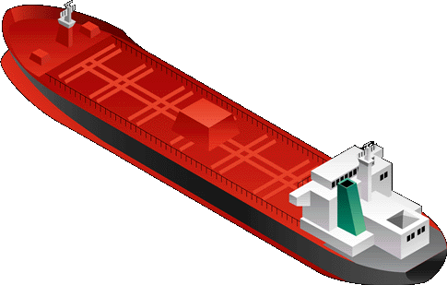

ESP Stainless Steel Supply Chain
Major
Service
Centers
Regional
Service
Centers
Foreign Mills
End
Users
Aerospace
ESP Inventory Support
Centers
Schmolz&Bickenbach
Bollinghaus
BGH
Italfond
Lucchini
Roda
Valbruna
Gloria
Venus Wire
DSS
Walsin
Domestic Mills
Medical
Outokumpu
Electralloy
N. Amer. Stainless
Crucible
Dunkirk / Universal
Oil Patch
Legend
DFARs
Vendor
Industrial

Slide 7
Inventory Strategy leveraging ESP Inventory Support Centers
Leverage ESP to maximize inventory turns and margins while meeting customer service demands
High Volume/
High Turns
Service Center
Stainless Steel Product Lines
Low Volume/
Low Turns
Commodity Products
Specialty Products
Low Margin
High Margin
Leverage ESP as your primary
Stocking Partner to maximize
Turns, Service, and Margins
Buy from mills as lead times and
Volumes allow; Use ESP to fill
short-term holes as required

Slide 8
ESP Specialty Steel Products
Stainless Steel Bar
  Round
  Square
  Hex
  Flats
Pump Shaft Quality
  316L
  416
eServices
  eServices on web site
  Virtual Inventory
Value-Added Services
  Cutting
  Packaging
  Delivery
303,304/L,316/L
17-4 Cond A/H1150
410,416,420,440C
Oil Patch
17-4 HH1150
410 QDT
420 MOD
9 CR 1MO

Slide 9
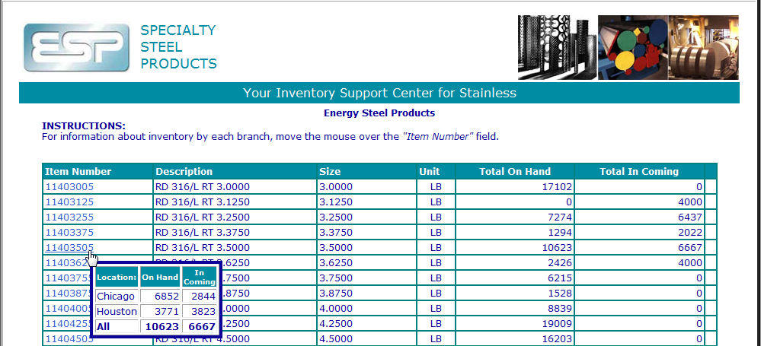
e-Services – online inventory
We can also publish our inventory DIRECTLY into your systems so you can see our stock as another “Virtual” inventory location.

Slide 10
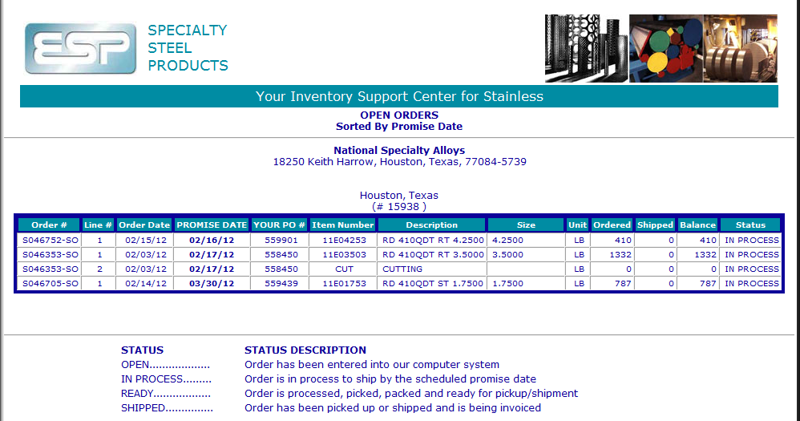
e-Services – Open Order Status

Slide 11
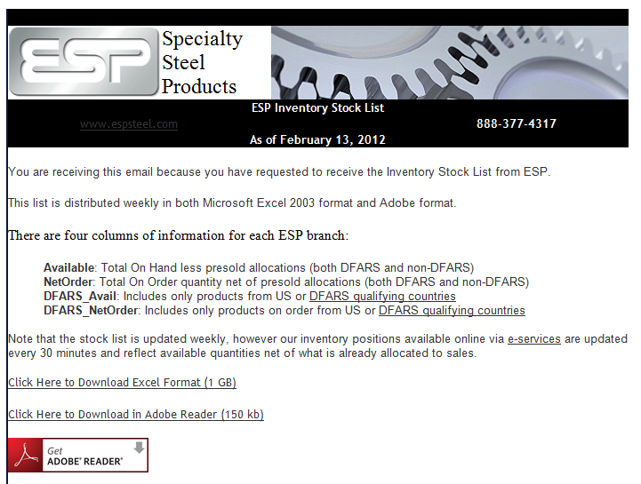
Weekly Inventory List Distribution via Email

Slide 12
Thank You……
Any Questions?
888-377-4317

