Slide 1
Introduction to Stainless Steel
November 2014

Slide 2
OUTLINE
WHAT IS STAINLESS STEEL?
WHY CHOOSE STAINLESS?
PRODUCT FORMS
HOW IS IT MADE?
5 CLASSES OF STAINLESS
ANNEALING & INTERGRANULAR CORROSION

Slide 3
Recipe for Steel (“Pig Iron”)
Iron (or iron-bearing material)
Coke (baked coal)
Limestone
Oxygen and Water
Heat to 3400˚ F
Notes:
Limestone promotes slag formation when the iron ore is melted. It combines with the acid impurities and floats to the top for skimming.

Slide 4
Notes:
Mythical Valyrian Steel mentioned in “Game of Thrones”

Slide 5
PROBLEM
ALL METALS OXIDIZE
Gold turns green
Silver turns black
Aluminum turns white
Copper turns green

Slide 7
Steel turns RED (RUST)
iron oxide
Iron has an affinity for Oxygen

Slide 8
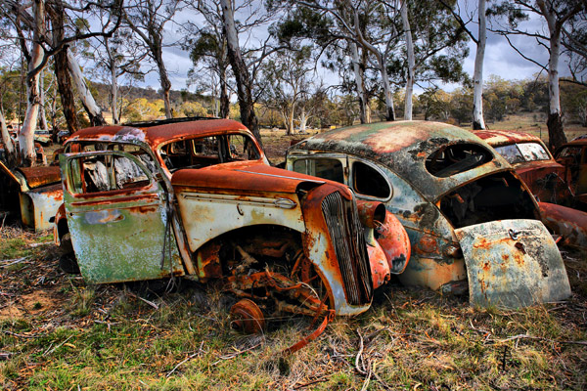

Slide 9
SOLUTION
At the last turn of the century, metallurgists
noticed that CHROMIUM had a greater affinity
for Oxygen than Iron.
When they added CHROMIUM to steel (over 10%), they discovered that steel did not rust under ordinary conditions.

Slide 10
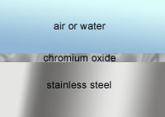
STAINLESS STEEL ALSO “RUSTS” BUT…
Chromium (when present in amounts of 10% or more) teams up with Oxygen in the atmosphere to form a very tight, transparent film on the surface of the steel.
The Chromium prevents iron from teaming up (bonding) with the Oxygen to form Iron Oxide.
Notes:
This process is called “self-passivation”

Slide 11
WHY CHOOSE STAINLESS?
Corrosion resistance
Mechanical properties
High temperature properties
Low temperature properties
Physical properties
Ease of Fabrication
Appearance
Life Cycle Cost
Notes:
Stainless Steel is 100% recyclable

Slide 12
STAINLESS STEEL PRODUCT FORMS
INGOT SHEET
BILLET STRIP
BLOOM CASTINGS
SLAB EXTRUDED SHAPES
PLATE COIL ROLLED SHAPES
SHEET COIL FORGINGS
WIRE PLATE
ROD (COIL) TUBULAR PRODUCTS
ESP STOCKS BAR PRODUCTS

Slide 13
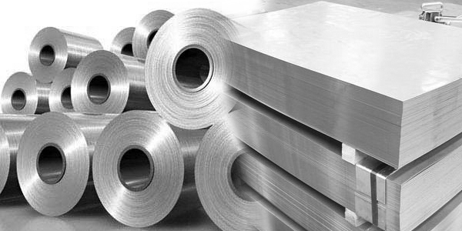
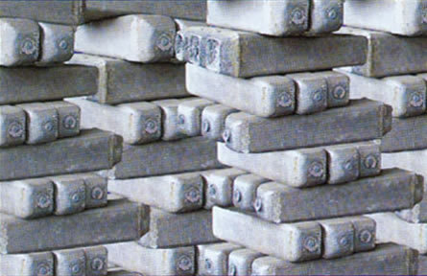
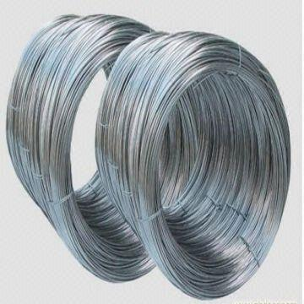
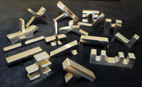
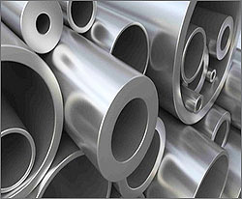

Slide 14
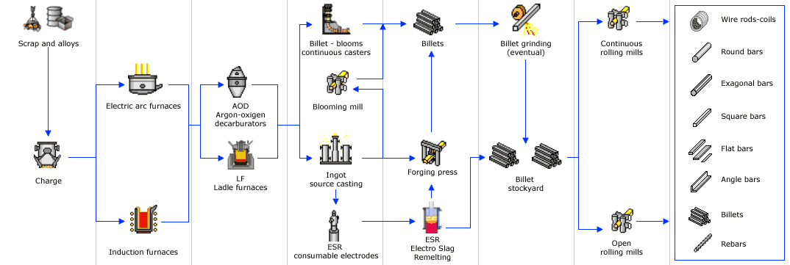
FROM MELT TO BAR PRODUCTS

Slide 15
FINISHING

Slide 16
5 CLASSES OF STAINLESS
400 Series, non-hardenable*, magnetic, FERRITIC
400 Series, hardenable*, magnetic, MARTENSITIC
200 & 300 Series, non-hardenable, non-magnetic, AUSTENITIC
Ferritic-Austenitic combination, non-hardenable, magnetic, DUPLEX
Precipitation hardening, hardenable, magnetic, PH GRADES
Notes:
The versatile family of stainless steels are an alloy system capable of providing a wide range of corrosion resistance, strength, and workability.

Slide 17
400 Series FERRITIC
Non hardenable, magnetic
T409 10.5-11.7% CR, originally designed for muffler stock and exterior parts in non-critical corrosive applications. Economical and easily fabricated
T430 16-18% Cr, most widely used of the non-hardenable chromium types. Much better corrosion resistance than T409
Notes:
This class is so named because the crystal structure of the steel is the same as iron (Fe) at room temperature. Chromium FERRITIC grades are normally selected for their increased corrosion resistance, rather than tensile strength. Their ferritic structure makes them NON-HARDENABLE and magnetic in all conditions.

Slide 18
400 Series MARTENSITIC
HARDENABLE by heat treatment, magnetic
T410
T410 QDT
T416
T420 MOD
T440C
Notes:
ESP stocks all of these grades. Different quenching conditions determine hardenbability. However, development of mechanical properties through quenching and tempering is inevitably associated with increased susceptability to corrosion.

Slide 19
T410 Annealed
Heat-Treatable stainless widely used where corrosion is not severe: air, fresh water, some chemicals and food acids. Typical uses include valve and pump parts, fasteners, cutlery, turbine parts and bushings.
Notes:
Chromium MARTENSITIC grades are not as corrosion resistant as the other classes, but are selected for their STRENGTH as well as their resistance to WEAR and ABRASION. Their MARTENSITIC structure makes them HEAT TREATABLE to a wide range of hardness and strength levels.

Slide 20
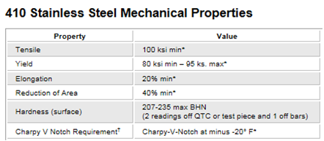
410 QDT
410 QDT is suitable for petrochemical applications such as oilfield sour gas hydrogen sulfide (H2S) service. DOUBLE tempering helps relieve internal stresses and guarantees that no untempered martensite remains in the steel.

Slide 21
T416 Stainless
Free-Machining variation of T410
Achieved by an increase in SULFUR
Useful corrosion resistance

Slide 22
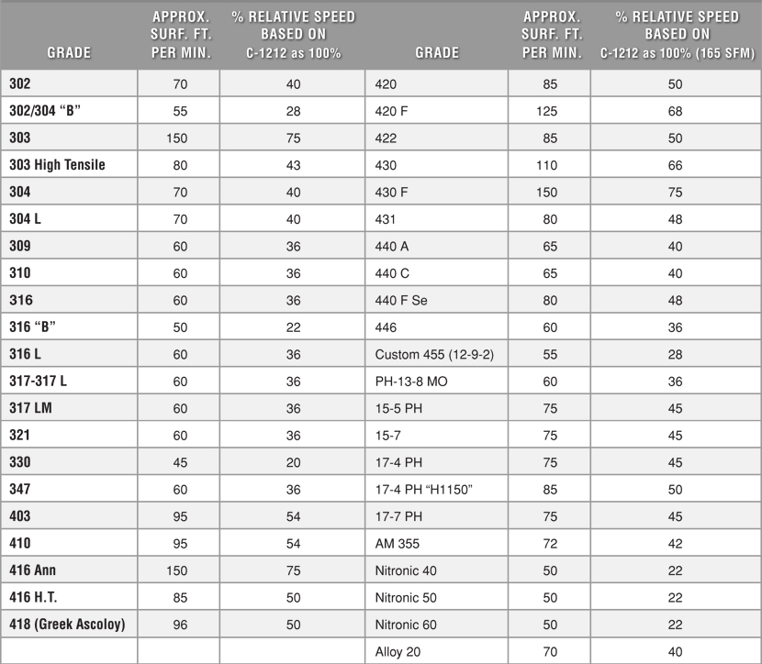

Slide 23
T420 Modified Annealed Stainless
Type 420, a modification of 410, has a higher carbon content to increase hardness, improve strength and give better wear resistance. This type maintains its best corrosion resistance in the heat treated condition. Tempering temperatures above 700⁰ F. are not normally recommended and T420 must be preheated before and annealed after welding.
Principal applications: Bushings, Dental and Surgical Instruments, Pump Parts, Valve parts, and shafts. Our 420 is not bought or recommended as a cutlery grade.
Analysis
C .22 - .27
Mn 1.00 Max
Si 1.00 Max
P .040 Max
S .030Max
Cr 12.5/14.00

Slide 24
T440C
High-Carbon chromium steel
Provides stainless properties with maximum hardness
Higher Chrome content than T410,T416, or T420
Notes:
.95-1.20 Carbon vs. .15 max for T410 . Chrome content 16.00-18.00 vs. 11.00 or 12.00 for the lower Martensitics

Slide 25
200 and 300 Series AUSTENITIC
Not heat-treatable
Superior corrosion resistance
Non-magnetic
Easily fabricated
Notes:
The high temperature form of iron is known as AUSTENITE (carbon in solid solution). The most common austenite retainer is nickel. Therefore, the traditional austenitic grades have 18% chrome for corrosion resistance plus 8% nickel to maintain the austenitic structure at room temperature.

Slide 26
T304 STAINLESS
AKA 18-8, increased chromium plus NICKEL, (18% chromium, 8% nickel)
Low carbon (.08 max) reduces intergranular corrosion associated with carbide precipitation that can occur during welding.
“L” grade lowers carbon content further (.03 max).
Notes:
T304 is the most versatile, popular, most widely applied stainless of the 300 series

Slide 27
ANNEALING
Heat through critical range to 1850 deg. F,
followed by rapid cooling (water quenching)
Redissolves carbides precipitated at grain boundaries during sensitization.
Result: Improved corrosion resistance

Slide 28
Why Anneal?
Soften steel
Improve or restore ductility
Improve machinability
Reduce internal stresses
For Cr-Ni stainless steels, annealing prevents decomposition of austenite (carbon in solid solution)

Slide 29
3 Things to Know:
Sensitization
Carbide Precipitation
Intergranular Corrosion

Slide 30
Sensitization
When austenitic steels are heated between 800 deg. and 1500 deg. F, they become sensitized.
Metals are crystalline in structure.
Metallic reactions tend to take place at the grain boundary regions.
Chromium and Carbon are normally distributed throughout the austenitic structure. This is commonly referred to as “in solution”.

Slide 31
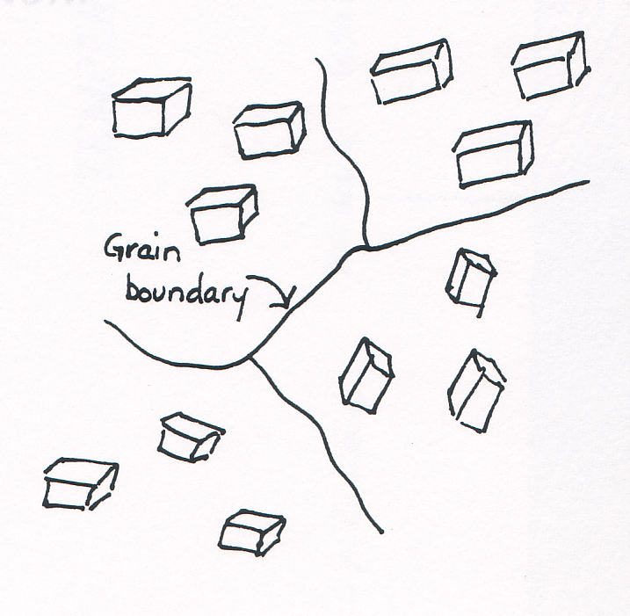

Slide 32
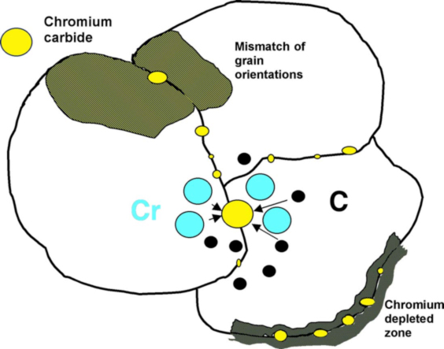

Slide 33
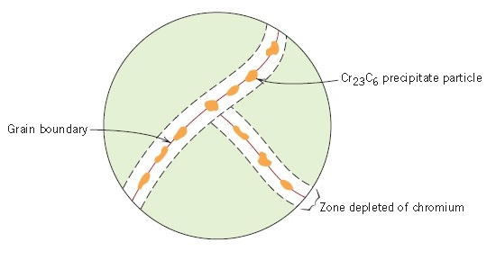

Slide 34
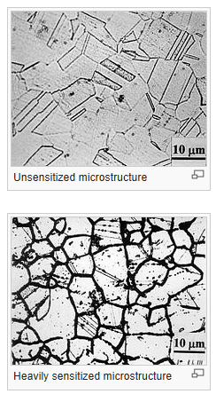
Sensitization
At a Critical Temperature
(about 1200 deg. F), carbon and chromium migrate toward the grain boundaries to form chromium carbides.

Slide 35
Sensitization
Sensitization (as a result of carbide precipitation) results in areas depleted of chromium. Without free chromium available to bond with oxygen, the chrome-oxide film is not able to form. Oxygen bonds with available iron, and rusting occurs. This is called intergranular corrosion.

Slide 36
Sensitization
At a Critical Temperature
(about 1200 deg. F),
Carbon and Chromium Migrate toward the
Grain Boundaries to Form Chromium
Carbides.

Slide 37
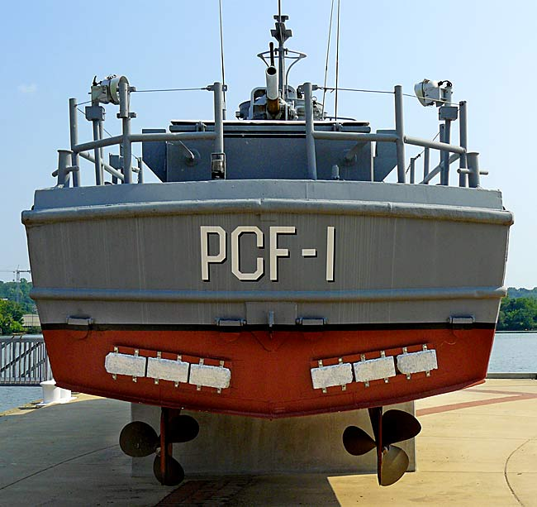

Slide 38
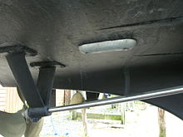

Slide 39
T316/L
T316 achieves superior corrosion resistance with the addition of more Nickel than 304…PLUS the addition of Molybdenum

Slide 40
T303 STAINLESS
Free-machining version of T304
Contains added phosphorus and sulfur for better machining characteristics
Corrosion resistance is slightly less than 304
Notes:
.15 max sulfur addition vs. .03 max sulfur in T304…a little higher carbon than T304 as well

Slide 41
Other Austenitic Grades
T321: stabilized with Titanium (for weldments subject to severe corrosion)
T347: stabilized with Columbium and Tantalum (prevents carbide precipitation)

Slide 42
ALLOYING ELEMENTS
Corrosion Resistance (Cr, Ni, Mo, Ti, Cb, C)
Scaling Resistance (Cr, Si)
Tensile Strength (Cr, Si, C)
Yield Strength (Mn, C)
Wear Resistance (Cr)
Ductility (Ni, Si)
High Temp Strength (Ni, Mo)
Hardness (Si, C)
Machinability (S)
Hardenability (Al)
Hot Working (Mn)
Notes:
USED TO AFFECT PERFORMANCE CHARACTERISTICS OF STAINLESS STEEL

Slide 43
ABBREVIATIONS FOR ALLOYING ELEMENTS
Aluminum Al
Carbon C
Chromium Cr
Columbium Cb
Niobium Nb
Magnesium Mg
Manganese Mn
Molybdenum Mo
Nickel Ni
Nitrogen N
Phosphorous P
Selenium Se
Silicon Si
Sulfur S
Titanium Ti
Tantalum Ta

Slide 44
DUPLEX STAINLESS
Family of Stainless Steels with a structure that consists of approximately 50% AUSTENITE and 50% FERRITE
Better corrosion resistance, superior strength
E.g.: Alloy 2205 (22Cr-5Ni-3Mo-15N)

Slide 45
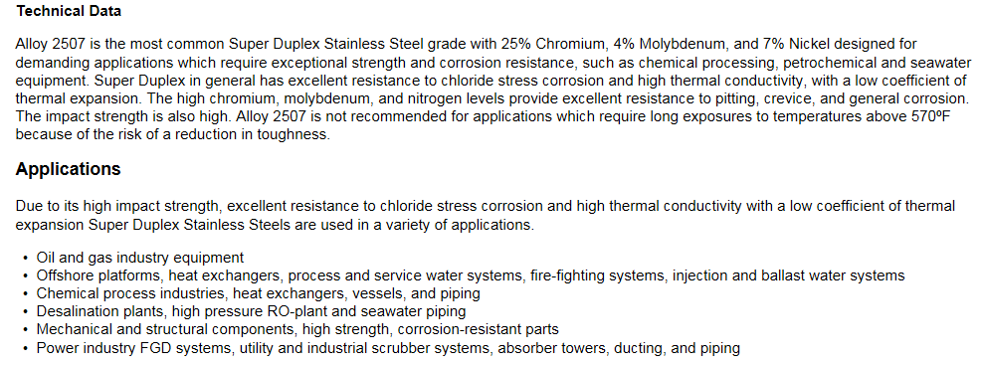
SUPER DUPLEX

Slide 46
PH Grades
Martensitic, magnetic
Excellent Strength
Good corrosion resistance
Mechanical properties can be improved by age-hardening
Notes:
Common PH grades are 17-4 and 15-5…PH stands for Precipitation Hardening

Slide 47
17-4 PH
Notes:
17-4 annealed combines high strength and hardness with corrosion resistance similar to T304. Easily heat treated at low temperatures from 900 to 1150 degrees F…eliminates scaling and prevents excess warpage. H1150 is solution annealed and age-hardened at 1150 degrees to improve mechanical properties and resistance to stress-corrosion cracking.

Slide 48
What is17-4 HH1150?
Optimum machinability can be achieved by heating condition A (solution annealed) materials between 1300˚F and 1500˚F, holding for 2 hours, then air cooling, followed by reheating to 1150˚F for 4 hours and allowed to air cool for the second time.
Notes:
Used in pressure-control applications in the energy industry.

Slide 49
Stainless Applications by Grade
303: | Shafts, fittings, screws, nuts, bolts
304/L: | Welding, valves, fittings, flanges, shafts
316/L: | Marine applications, pumps, shafts, gears, valves, fittings
410: | Valves, pumps, knives, fasteners, hand tools
416: | Screw machine parts
420: | Medical instruments, oil and gas drilling/production
440C: | Pivot pins, valve parts, oil well pumps, knives, surgical & dental equipment
17-4: | Aircraft, military, boat shafts, valves, pumps, medical

Slide 50
Review: History video
http://www.imoa.info/video/100_Years/EN/DSL.html

Slide 51
Review: Self-Passivation video
http://www.imoa.info/video/selfrepairing/DSL.html

Slide 52
Review: Alloying Elements video
http://www.imoa.info/video/alloyed/DSL.html

Slide 53
THANK YOU!

