Slide 1
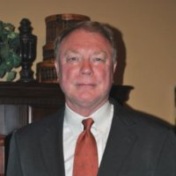
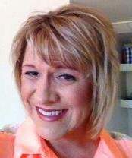
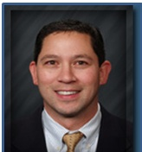
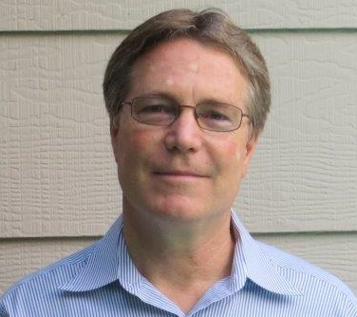
ESP Sales Contacts
Bob Dudzik
Audra Deems
Ed Nunez
Dave Griffin
Wes Morgan
John
Buras
Stefani Salinas
Notes:
Bob

Slide 2
 |  | Direct Line | Cell Phone
Bob Dudzik | CEO | 281-760-0420 | 713-501-2024
Dave Griffin | Sales | 281-760-0426 | 713-501-2720
Wes Morgan | Sales | 281-760-0421
John Buras | Sales | 281-760-0422
Stefani Salinas | Sales | 281-760-0430
Audra Deems | Outside Sales - South |  | 713-501-2485
Ed Nunez | Outside Sales - North |  | 414-803-9790

