Slide 1
ESP Specialty Steel Products
Commitment to our Customer

Slide 2
Our Goal
To be a valued supplier
To be a business partner to help you achieve your goals / metrics
Increase your sales
Reduce inventory
Improve inventory turns
Increase customer satisfaction
Improve productivity / efficiency
Joint planning to ensure a win-win proposition
Regular reviews to measure success and identify areas for improvement

Slide 3
ESP Role with our Customers
A Simple Role for ESP to Play
Let us fill the holes you get in ‘A’ items
Let us be your inventory holder for ‘B’ and ‘C’ items
On stock specials or non stock items, let us be your supplier. These are items you hold special for your customer
We provide saw cutting services to improve delivery lead time to your customer by eliminating extra handling as well as eliminate slow moving drops
We provide end to end service by responding to quotes on a timely basis; providing order acknowledgement, MTR’s and packing slips via email ahead of receipt; and loading your trucks in an efficient and timely manner
We will create a plan to jointly approve and work on (This creates commitment on both sides)

Slide 4
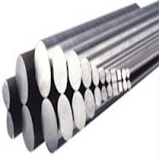
Stock Specials
Stock specials are items you have in your inventory that you brought in for a specific end use customer.
These can be either stock items, a variation of a stock item (e.g. longer length), or a non stock item
These items typically are under more scrutiny since they have higher risk
These usually involve a target customer that you have made a commitment to supply
These items can be low margin
Failure to uphold your end of commitment can be devastating to your relationship, even business

Slide 5
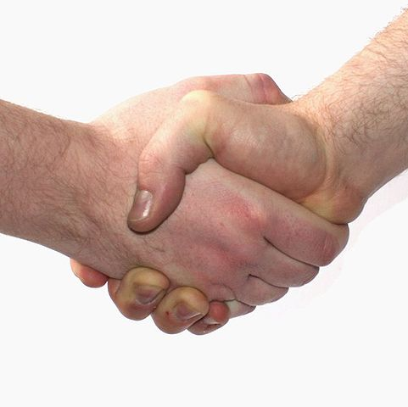
Stock Specials
How can ESP help
We can take on the responsibility to stock the item and release to you as needed
We can act as a backup to support you when unusual high demand puts you in an out of stock or very low stock position
We can improve your turns and
earns when margins are tight
A commitment to finally release
all stocks from ESP will be required

Slide 6
Stock Specials
Benefits to You
Reduces your risk
Improves turns on these items
Improves on time delivery to your end customer
Ensures your customer satisfaction
Puts you in a position to grow business at end customer

Slide 7
Final Note
To make a business relationship work, trust is a key. We will build that trust through
Open and honest communications
Impeccable service. We will do what we say
Sharing and volunteering information
Demonstrating a strong moral ethic

